Slide 1
Note for SDLAs: Tailor your presentation
This presentation is a comprehensive set of slides that you can customize and use to educate ELDT stakeholders; including training providers, driver-trainees, or skills and knowledge test examiners.
Look at the section titles, then select the slides that will be most relevant to your audience.
Update the Agenda slide to reflect only the topics you will cover.
Tailor the slide notes as needed.
Delete this slide and update any text shown in red before presenting to your audience.
Revised 4/1/2023

Slide 2
MINIMUM TRAINING REQUIREMENTS FOR Entry-Level Commercial Motor Vehicle Operators
Audience/group for presentation
Date

Slide 3
Agenda
1
4
THE ELDT REGULATIONS
TRAINING PROVIDER REQUIREMENTS
What are they, and how do they improve safety?
What do the ELDT regulations require of training providers?
2
5
CDL APPLICANT REQUIREMENTS
THE TRAINING PROVIDER REGISTRY
What do the ELDT regulations require of CDL applicants?
What is it, and how does it support the ELDT regulations?
3
TRAINING REQUIREMENTS
6
USING THE TRAINING PROVIDER REGISTRY
What theory and behind-the-wheel training must entry-level drivers complete?
How can CDL applicants, training providers, and licensing agencies use the Registry?

Slide 4
The ELDT Regulations

Slide 5
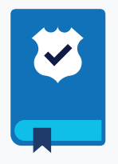
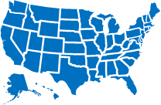
What are the Entry-Level Driver Training (ELDT) regulations?
ELDT regulations set minimum Federal requirements for theory and behind-the- wheel training.
Entry-level large truck and bus drivers must complete required training before testing for certain types of commercial driver's licenses (CDLs) and certain CDL endorsements.
States may have requirements that exceed the Federal requirements.
Notes:
Operating a commercial motor vehicle (CMV), such as a large truck or bus, is a vital job, moving goods and people across the Nation. It’s also a heavy responsibility, and requires a higher level of knowledge, experience, skills, and physical ability than that required to drive a non-commercial vehicle.
A commercial driver’s license (CDL) is required to operate certain CMVs.
Until recently, individuals applying for CDLs were not required, at a Federal level, to complete training before testing for a CDL, though some States have their own CDL training requirements. This changed on February 7, 2022, when the Entry-Level Driver Training (ELDT) regulations were implemented.
With input from driver and training organizations, motor carriers, state licensing agencies, safety advocacy groups, and insurance companies, the Federal Motor Carrier Safety Administration (FMCSA) developed the training requirements and curricula to ensure that all entry-level drivers complete uniform theory and behind-the-wheel training before being permitted to take a CDL skills or knowledge test.

Slide 6
How does ELDT improve safety on our Nation’s roads?
Ensures that only qualified drivers receive a new CDL, a CDL upgrade, or a school bus (S), passenger (P), or hazardous materials (H) endorsement.
Sets a national baseline for entry-level driver training.
Identifies standards that training providers must meet.
Gives States information they need at critical safety checkpoints.
Further ensures that drivers operate commercial motor vehicles (CMVs) safely and meet their operational responsibilities.
Notes:
The Training Provider Registry is a critical piece of the Entry-Level Driver Training Program. By receiving and retaining driver certification information from training providers and relaying it to States, the Training Provider Registry ensures that the requirements of the Entry-Level Driver Training (ELDT) regulations are met.

Slide 7
CDL Applicant Requirements

Slide 8
The ELDT regulations establish minimum training standards for entry-level drivers.
This includes individuals applying for:
A Class A or Class B commercial driver’s license (CDL) for the first time
An upgrade of an existing Class B CDL to a Class A CDL
A hazardous materials (H), passenger (P), or school bus (S) endorsement for the first time
The rule does not cover individuals for whom States have waived the CDL skills test under 49 CFR part 383.
Notes:
The ELDT regulations established Federal minimum training requirements for entry-level drivers. Who is considered an entry-level driver? [ read slide ]

Slide 9
What do the ELDT regulations require of CDL applicants?
Entry-level drivers must complete the applicable training from a registered training provider.
Must be completed prior to taking a CDL skills test or, if applying for the H endorsement, knowledge test.
Individuals who obtain a commercial learner’s permit (CLP) on or after February 7, 2022 are required to meet the ELDT requirements.
Individuals who obtained a CLP before February 7, 2022 are not subject to the new ELDT regulations, so long as they obtain a CDL or endorsement before their CLP (or renewed CLP) expires.

Slide 10
ELDT Applicability
If Then
A driver holds a CLP that was issued before February 7, 2022…
The driver is not required to complete entry-level driver training, as long as the driver obtains a CDL before the CLP expires.
A driver was issued a CDL or an S, P, or H endorsement before February 7, 2022…
The driver is not required to complete entry-level driver training for the previously-issued license or endorsement, even if it has since lapsed.
A driver holds a CLP that was issued before February 7, 2022, but the CLP expires before the driver applies for their CDL…
The driver must complete the required entry-level driver training before being permitted to take the CDL skills test.
A driver obtains a CLP on or after February 7, 2022…
The driver must complete the required entry-level driver training before being permitted to take the CDL skills test, S or P skills test, or H knowledge test.
A driver held a CDL prior to the compliance date, and applies for an upgrade to a higher class of CDL, or an S, P, or H endorsement for the first time on or after February 7, 2022…
The driver must complete the required entry-level driving for the class of CDL to which the driver is upgrading or the endorsement(s) for which the driver is applying before being permitted to take the applicable CDL skills test or H endorsement knowledge test.
For more information, download the ELDT Applicability Factsheet
Notes:
Refer to:
§380.603 Applicability.
(a) The rules in this subpart apply to all entry-level drivers, as defined in this subpart, who intend to drive CMVs as defined in §383.5 of this chapter in interstate and/or intrastate commerce, except:
(1) Drivers excepted from the CDL requirements under §383.3(c), (d), and (h) of this chapter;
(2) Drivers applying for a restricted CDL under §383.3(e) through (g) of this chapter;
(3) Veterans with military CMV experience who meet all the requirements and conditions of §383.77 of this chapter; and
(4) Drivers applying for a removal of a restriction in accordance with §383.135(b)(7).
(b) Drivers issued a Class A CDL, Class B CDL, or a passenger (P), school bus (S), or hazardous materials (H) endorsement before February 7, 2022, are not required to comply with this subpart pertaining to that CDL or endorsement.
(c)(1) Individuals who obtain a CLP before February 7, 2022, are not required to comply with this subpart if they obtain a CDL before the CLP or renewed CLP expires.
(2) Individuals who obtain a CLP on or after February 7, 2022, are required to comply with this subpart.
(3) Except for individuals seeking the H endorsement, individuals must complete the theory and BTW (range and public road) portions of entry-level driver training within one year of completing the first portion.

Slide 11
Training Requirements

Slide 12
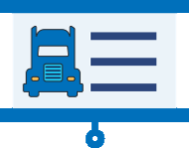
What training will CDL applicants receive?
Entry-level drivers must receive training and demonstrate proficiency in the following areas:
THEORY TRAINING | BEHIND-THE-WHEEL (BTW) TRAINING
Lectures, demonstrations, computer-based, online learning, etc. May use a simulator No minimum number of hours; trainees must score at least 80% on assessment Training topics include: Basic Operation Safe Operating Procedures Advanced Operation Procedures Vehicle Systems and Reporting Malfunctions Non-Driving Activities (e.g., Hours of Service) | Actual operation of a CMV Takes place on a range or public road May not use a simulator to meet requirements No minimum number of hours, training provider will determine driver’s proficiency Basic vehicle control skills and mastery of basic maneuvers
States may have requirements that exceed the Federal requirements.

Slide 13
Training Requirements
Theory and BTW trainings may be delivered by different training providers.
Both training providers must be registered/listed on the Training Provider Registry.
Both training providers must separately submit driver training information.
BTW range and BTW public road trainings must be provided by the same training provider.
Driver-trainees must complete both the theory and BTW portions of training within one year of each other.
Notes:
Note that drivers may complete theory training and behind-the-wheel training with separate training providers.
Because of this, the training providers must submit the driver training certification information when the theory training program is complete, or when the behind-the-wheel training program is complete, rather than wait until the driver has completed all courses in a curriculum.

Slide 14
Training Requirements (continued)
BTW Public Road
Instructors must cover all topics listed and “determine and document that each driver-trainee has demonstrated proficiency in all elements of the BTW curriculum unless otherwise noted.”
See Appendices A and B to part 380.
Does not allow for “test outs” of skills training on either range or public road.

Slide 15
Additional State Training Requirements
States to fill in bullets on this slide, as applicable

Slide 16
Training Provider Requirements

Slide 17
What is a training provider?
An entity that is listed on the FMCSA Training Provider Registry.
Training schools
Educational institutions
Rural electric cooperatives
Motor carriers
State/local governments
School districts
Joint labor management programs
Owner-operators
Individuals
May include:
Notes:
What is FMCSA’s definition of a training provider? [ read screen ]

Slide 18
Training Provider Requirements
REGISTRATION
CURRICULA
INSTRUCTORS
FACILITIES
VEHICLES
STATE LICENSING
ASSESSMENTS
TRAINING CERTIFICATION
DOCUMENTATION
FMCSA AUDITS
For full training provider requirements, see 49 CFR part 380, subparts F & G.
Notes:
When you register on the Training Provider Registry, you will have to certify that you comply with all Federal requirements, and applicable State requirements in the States where you conduct training.

Slide 19
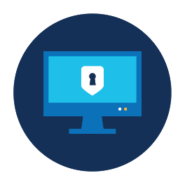
Registering with FMCSA
► For more information: § 380.703
To be authorized to provide entry-level driver training, training providers must register with FMCSA.
During registration, training providers must self-certify that they meet all applicable Federal and State requirements.
Only registered training providers will:
Be listed on the Training Provider Registry website.
Be able to submit driver training certification information to FMCSA.
Training providers are required to register even if they do not provide training to the general public.
Providers may omit their contact information from the public list.

Slide 20
Curricula
Training providers must cover all topics described in 49 CFR part 380 appendices A through E, as applicable
There is no required minimum number of instruction hours.
Separate training providers may deliver the theory and behind-the-wheel (BTW) portions of the training, but both portions of BTW training must be delivered by the same training provider.
Driver-trainees must complete both the theory and BTW portions of training within one year of each other.
Except for individuals seeking the H endorsement
A simulation device cannot be used for BTW instruction, but can be used as part of theory instruction.
Download the ELDT Curricula Summary for an overview of requirements..

Slide 21
Instructors
► For more information: §§ 380.713, 389.605
Theory and BTW instructors must hold a CDL of the same (or higher) class and with all endorsements necessary to operate the CMV for which training is to be provided.
They must also have either:
At least two years of experience driving a CMV requiring a CDL of the same (or higher) class and/or the same endorsement; or
At least two years of experience as a behind-the-wheel CMV instructor.
If an instructor’s CDL has been cancelled, suspended or revoked due to offenses identified in § 383.51, the instructor is prohibited from teaching for two years following the date his/her CDL is reinstated.
Notes:
For instructors, 2 years is the magic number to remember. Instructors must hold a CDL of the same of higher class with all the necessary endorsements for the type of training provided, and must have:
At least 2 years experience driving the type of CMV for which driving is being provided, or
At least 2 years experience as a BTW CMV instructor.
If a license is cancelled, suspended, or revoked. The instructor cannot provide training until at least 2 years have passed since the CDL was reinstated.

Slide 22
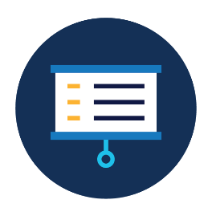
Facilities
► For more information: § 380.709
Classroom and range facilities must comply with all applicable Federal, State, and/or local statutes and regulations.
“Range” means an area that:
Is free of obstructions;
Has adequate sight lines; and
Enables the driver to maneuver safely and free from interference from other vehicles and hazards.
Training providers may conduct BTW range training in any area that meets the three above requirements. They are not required to maintain or rent a private facility or space.
If range training is conducted in publicly accessible area, all CLP requirements also apply.
Notes:
Note that FMCSA doesn’t have any specific facility requirements, but the Dept. of Labor (OHSA) and Dept. of Education, as well as other agencies may regulate facilities. Training providers are responsible for knowing and complying with all applicable regulations.

Slide 23
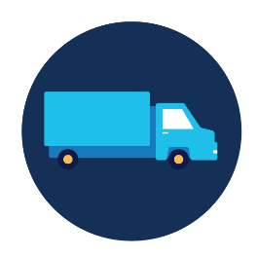
Vehicles
► For more information: §§ 380.711, 392, 393, 396
Vehicles must comply with applicable Federal and State safety requirements.
Vehicles must be in the same group and type that driver-trainees intend to operate for their CDL skills test.
Notes:
FMCSA vehicle requirements can be found in parts 392, 393, and 396.

Slide 24
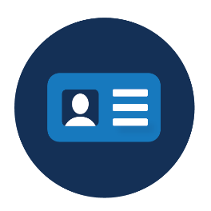
State Licensing
► For more information: § 380.703
Training providers must be licensed, certified, registered, or authorized by the State where the training is conducted, as applicable.
Note: Some States may not have instructor certification requirements for entry-level driver training providers.
Training providers offering online content exclusively are not required to meet State qualification requirements for theory instructors.
Notes:
Note that while State licensing requirements do not apply to providers that only provide theory training online. Online theory trainers must still comply with applicable Federal and State curricula requirements in the States where training is conducted.

Slide 25
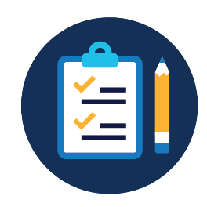
Assessments
► For more information: § 380.725
Theory Training
Training providers must use assessments (in written or electronic format) to determine trainees' proficiency with all units in the theory curriculum.
Students must earn a minimum overall score of 80 percent.
BTW Training
Training instructors must evaluate and document a trainee's proficiency in BTW skills.
Training instructors must document the total number of clock hours each trainee spends to complete the BTW curriculum, but there is no minimum number of training hours required.

Slide 26
Driver Training Certification
The following training certification information must be submitted to the Training Provider Registry by midnight of the second business day after each student completes training:
Driver-trainee name, date of birth, and license/permit number and State of issuance.
CDL class/endorsement and type.
Specifics about the type of training completed (for example, theory or BTW).
Score on written theory assessment (if applicable).
Total number of clock hours spent BTW (if applicable).
Date of successful completion of training.
Notes:
The ELDT regulations require that training providers submit information to certify that drivers have completed a training course that meets ELDT standards by midnight of the second business day after each student complete a training course. This information will include (see slide).
You can submit driver training information by entering the information manually while logged in to the Training Provider Registry, or building a connection from your IT system to the Registry.

Slide 27
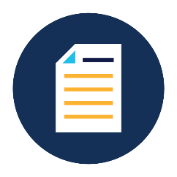
Documentation and Record Retention
► For more information: § 380.725
All training providers must retain specific records, including:
Self-certifications by accepted driver-trainees for BTW training attesting that they will comply with U.S. Department of Transportation regulations, as well as State and/or local laws related to controlled substances and alcohol testing, age, medical certification, licensing, and driving record.
A copy of the trainee's CLP or CDL.
Instructor qualification documentation.
Lesson plans for theory and BTW (range and public road) training curricula.
Records of individual entry-level driver training assessments.
Records must be maintained for at least 3 years.
Notes:
Note: Retention of records. Training providers listed on the TPR must retain the records identified in paragraph (b) of this section for a minimum of three years from the date each required record is generated or received, unless a record, such as a BTW instructor's CDL, has expired or been canceled, in which case the most recent, valid CDL should be retained, if applicable. The provisions of this part do not affect a training provider's obligation to comply with any other local, State, or Federal requirements prescribing longer retention periods for any category of records described herein.

Slide 28
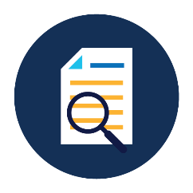
FMCSA Audits
► For more information: §§ 380.721, 380.723
Training providers must allow FMCSA or its authorized representative to audit their operations.
If FMCSA determines that a training provider does not meet all applicable requirements, FMCSA may remove the training provider from the Registry.
Any training conducted after a training provider’s removal date will be considered invalid.
Training providers who wish to remain listed on the Registry may appeal FMCSA’s decision or take corrective action.

Slide 29
Maintaining Registration
► For more information: § 380.719
Within 30 days of a change Update your registration with any changes to key information, such as:
Name, address, phone number.
Type(s) of training offered.
Training provider status.
Change in State licensure, certification, or accreditation status.
Biennial update Confirm your Training Provider Registry registration biennially, even if nothing has changed.
Notes:
For continued listing on the Registry, you must keep your information up to date. This means updating any information within 30 days of the change, and updating your listing every other year, even if nothing has changed.

Slide 30
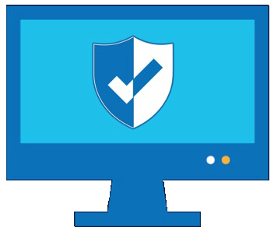
Training Provider Requirements – Submitting Driver Data
After a driver successfully completes the required training, the training provider must electronically submit the driver-trainee's training certification information to the Training Provider Registry.
Must be submitted by midnight of the second business day after the driver-trainee completes the training.

Slide 31
The Training Provider Registry

Slide 32
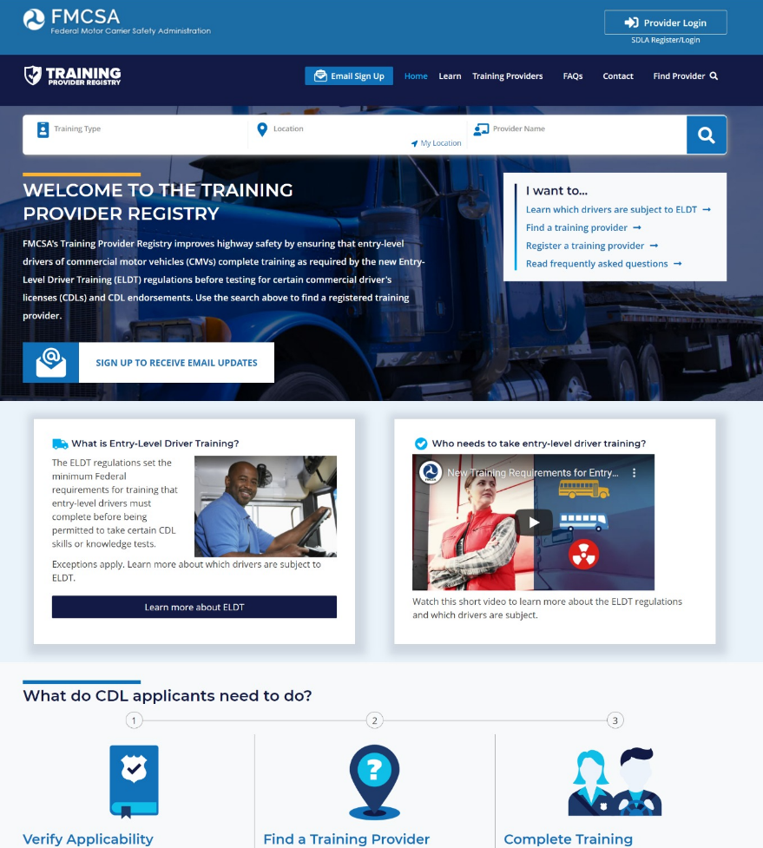
What is the Training Provider Registry?
An FMCSA web system that:
Lists training providers eligible to provide entry-level driver training.
Retains a record of drivers that have successfully completed entry-level driver training.
Ensures compliance with lifesaving Entry-Level Driver Training regulations
Notes:
The Training Provider Registry is a new FMCSA web system that:
Contains the list of all entities that register with FMCSA and self-certify they meet the requirements for being entry-level driver training providers.
Retains a record of drivers that have successfully completed entry-level driver training.

Slide 33
How does the Training Provider Registry support ELDT?
Search
DRIVER
selects registered training provider from list on Training Provider Registry, completes training
Submit
TRAINING PROVIDER electronically submits driver training data to Training Provider Registry
Retain
FMCSA
retains driver data in Training Provider Registry
Retrieve
STATE
retrieves driver data from Training Provider Registry
Notes:
Here’s a quick overview of how driver training certification information gets to the Training Provider Registry, and what happens to it.

Slide 34
ELDT and the Training Provider Registry
CDL applicant (driver) searches the list of training providers on the Training Provider Registry.
Driver contacts the training provider and secures their services outside the Training Provider Registry, and successfully completes required training.
Search

Slide 35
ELDT and the Training Provider Registry (continued)
Training provider submits driver training certification information to FMCSA electronically via the Training Provider Registry.
Driver information must be submitted by midnight of the second business day after the driver-trainee completes the training.
Must be done for each student when that student completes a training program.
Submit

Slide 36
ELDT and the Training Provider Registry (continued)
FMCSA will retain the driver training certification information securely in the Training Provider Registry.
Retain

Slide 37
ELDT and the Training Provider Registry (continued)
The State, prior to administering the relevant skills or knowledge test, must use information from the Training Provider Registry to verify that the driver has competed required training.
Retrieve
Notes:
Because the information is coming from the Training Provider Registry, and only registered training providers can submit driver data into the system, this retrieval confirms that the driver completed their training with a registered training provider.
Only training providers who are registered with FMCSA will be able to submit driver training certification information.
To help make sure drivers only arrive for their test once they are eligible, FMCSA will also offer a feature on the Training Provider Registry that will allow the driver to view his or her own record on the Training Provider Registry website. However, States may only accept driver training certification information from the Training Provider Registry to determine if a driver is eligible for the applicable skills or knowledge test.

Slide 38
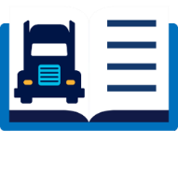
ELDT and the Training Provider Registry (continued)
The Registry is set up to accept submissions from multiple providers.
EXAMPLE:
Provider A submits certification for the theory training the driver completed with them.
Provider B submits certification for the BTW training completed with them.
All records are tied to CDL# 1234567 and can be queried by a State, the driver can also view their complete record.
TRAINING PROVIDER REGISTRY
CDL# 1234567
TRAINING PROVIDERS
BTW-Road
Theory
BTW-Range
Provider A
Provider B
Notes:
Read slide.

Slide 39
Using the Training Provider Registry

Slide 40
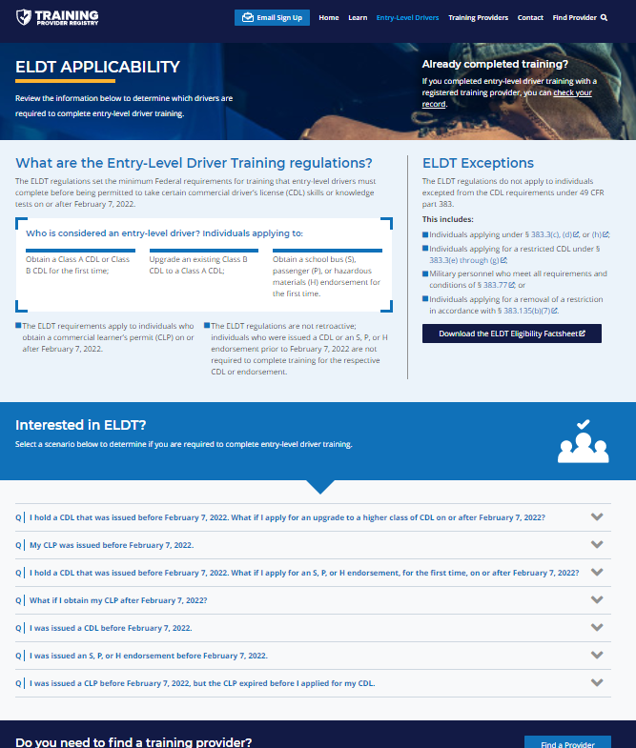
Drivers: Determine ELDT Applicability
Drivers should first determine if they are required to complete entry-level driver training.
Carefully review the regulations found in the Code of Federal Regulations (CFR), title 49, part 380, subpart F.
FMCSA has prepared these materials to assist drivers:
Download the ELDT Applicability Factsheet.
Watch the “Who needs to take entry-level driver training?” video.
Read the scenarios listed on https://tpr.fmcsa.dot.gov/Learn/ ELDT.
40
Notes:
Read slide.

Slide 41
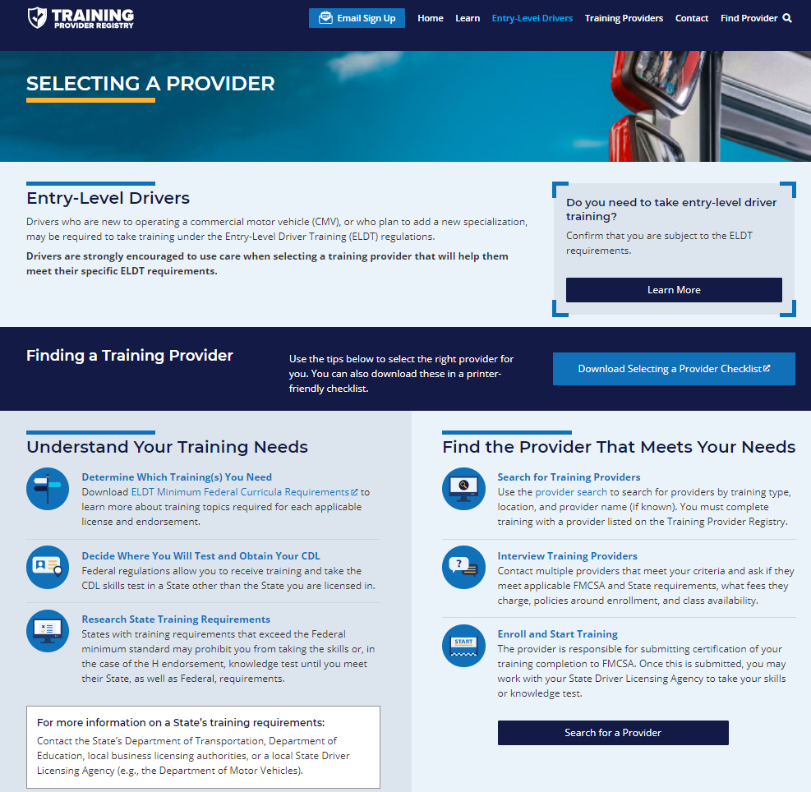
Drivers: Select a Provider
Drivers are strongly encouraged to use care when selecting a training provider that will help them meet their specific ELDT needs.
Understand your training needs.
Use the Training Provider Registry to find the provider that meets your needs.
FMCSA has prepared these materials to assist drivers:
Download the Selecting a Training Provider Checklist.
Visit the Selecting a Provider webpage.
41
Notes:
Read slide.

Slide 42
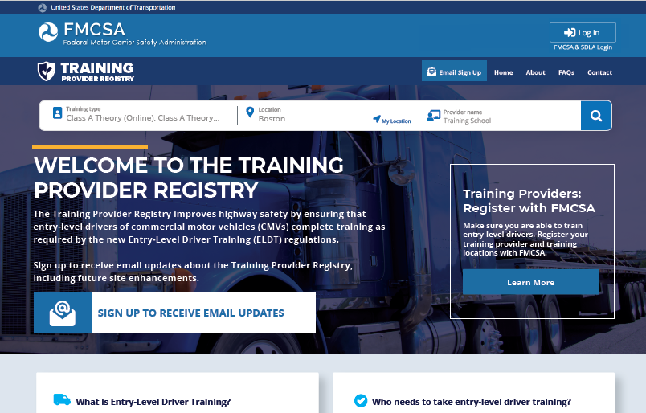
Drivers: Search for a Training Provider
Notes:
Any user can search for registered, approved training providers.
The search appears at the top of the TPR home page – as seen in this screen shot.
Users will enter their search criteria and click the magnifying glass icon to begin their search.
This home page serves as an information page for drivers about the ELDT regulations.

Slide 43
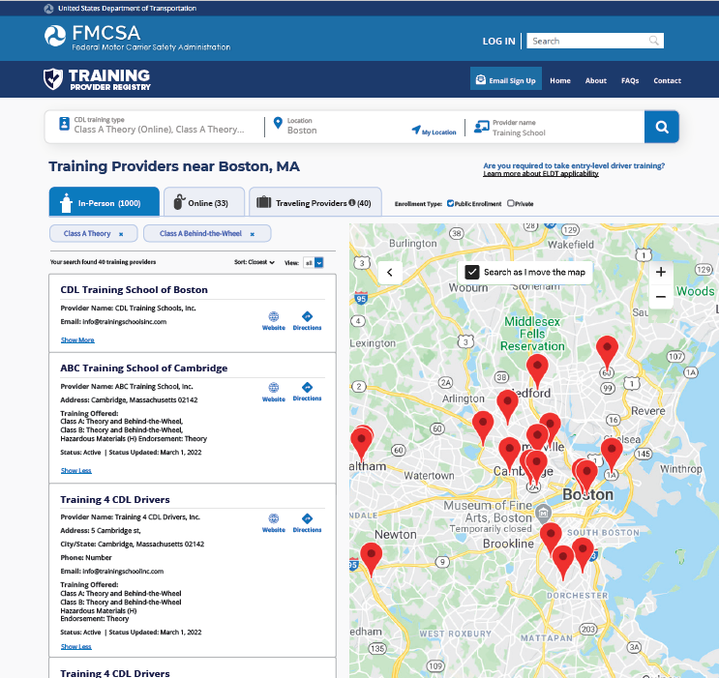
Drivers: Search for a Training Provider (continued)
Results list has 3 tabs:
In-person training locations
Online training
Traveling training providers
Notes:
Once a user enters their terms and clicks search, they are taken to the search results page.
The results will show a “short” version of the information—this includes the provider and location name and contact information. The user will click “View More” to see the full provider information, including the trainings offered. This will allow as many search results as possible to display on the screen.
The search results are broken up into 3 categories, with tabs to help the user navigate.
The first page they will see are the “in-person” training locations, with a map to help locate them.
Users can also click on the “Online” tab to view online (theory-only) training providers, or on the “Traveling Providers” tab to view providers who do not have a fixed training location.
There is an option to limit the search to Public Enrollment or Private Enrollment only.
We also have an option to “Download All,” which will allow users to download the spreadsheet that is available today.

Slide 44
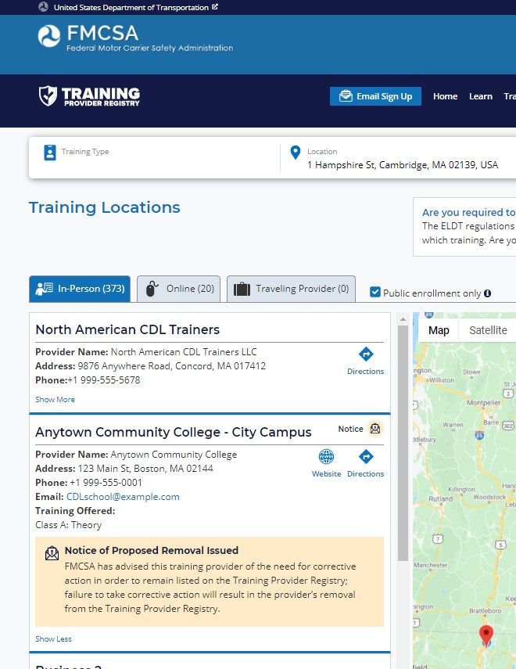
Drivers: Search for a Training Provider (continued)
This notice indicates that FMCSA has notified a training provider about the need to take corrective action.
For more information on the process for removal from the Registry, see 49 CFR 380.721 and 380.723.
Notes:
One other thing to note – in keeping with the ELDT regulations, we will be indicating if a provider has been notified of the need for corrective action. This screenshot shows an example of a traveling provider who has received this notification.
If the provider makes the necessary corrective actions within 60 days, this notice will be removed from the provider’s listing. If not, in keeping with the involuntary removal process outlined in § 380.723(b), the provider would no longer appear in search results.

Slide 45
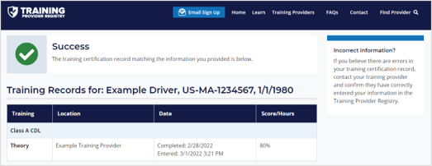
Drivers: Check Your Record
Driver-trainees can use the Record Check feature to see the certification information they have in the Registry.
Drivers will enter their name, CLP/CDL information, and answer a question about their training record to verify their identity.
Visit https://tpr.fmcsa.dot.gov/Check.
Notes:
Driver-trainees can use the Record Check feature to see the certification information they have in the Registry
Drivers will enter their name, CLP/CDL information, and answer a question about their training record to verify their identity
To start the record check drivers can visit the Training Provider Registry home page and scroll down to the “Start Record Check” button

Slide 46
Training Providers: Registration
Are you ready to register?
Ensure your curricula, documentation, vehicles, etc. meet the minimum ELDT standards.
When you register, you must self-certify that you comply with all applicable ELDT requirements.
For a complete list of training provider requirements, visit 49 CFR part 380. subparts F and G and appendices A through E.

Slide 47
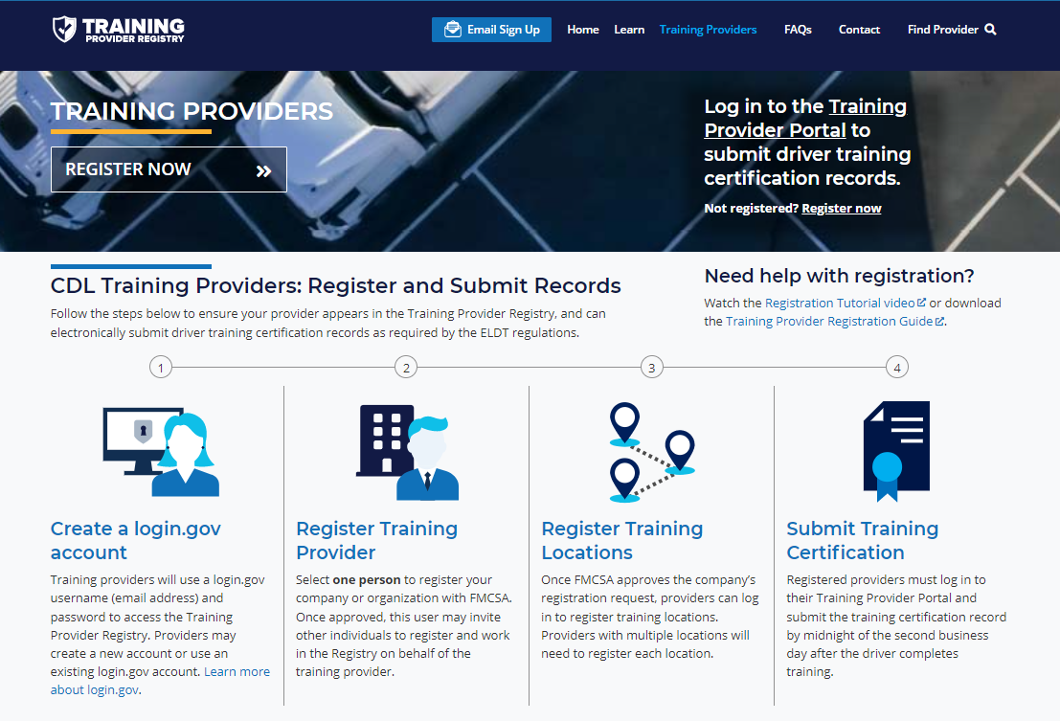
Training Providers: How to Register
One representative from the company/ organization completes the provider registration.
After provider registration is approved, user can invite additional users to access that company/ organization account.
Notes:
To register, visit the TPR home page, click Training Providers, and click Register Now
Make sure to note the steps of registration:
Create a login.gov account – this is a secure account you can use to access multiple government systems, including the Training Provider Registry
Register your training provider – one individual from each company or organization will register the provider with FMCSA
Then you must register your training location information

Slide 48
Training Location Registration
Once FMCSA has approved the training provider (company) registration, the provider must log in to register their training location or locations.
Location information is needed to:
Appear in the training provider search
Submit driver training certification information

Slide 49
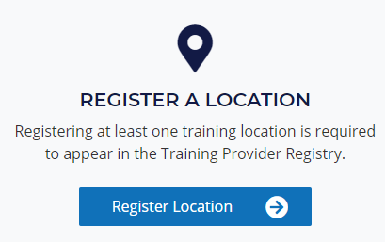
Training Providers: Register Your Location(s) (continued)
Click Register Locations in the Training Provider Portal (login required).
Follow the prompts to complete provider registration.
Download the Registration Guide on the Trainings Providers page: https://tpr.fmcsa.dot.gov/Provider
Once FMCSA has approved the location, you may submit driver training certification records for training conducted at that location.
49

Slide 50
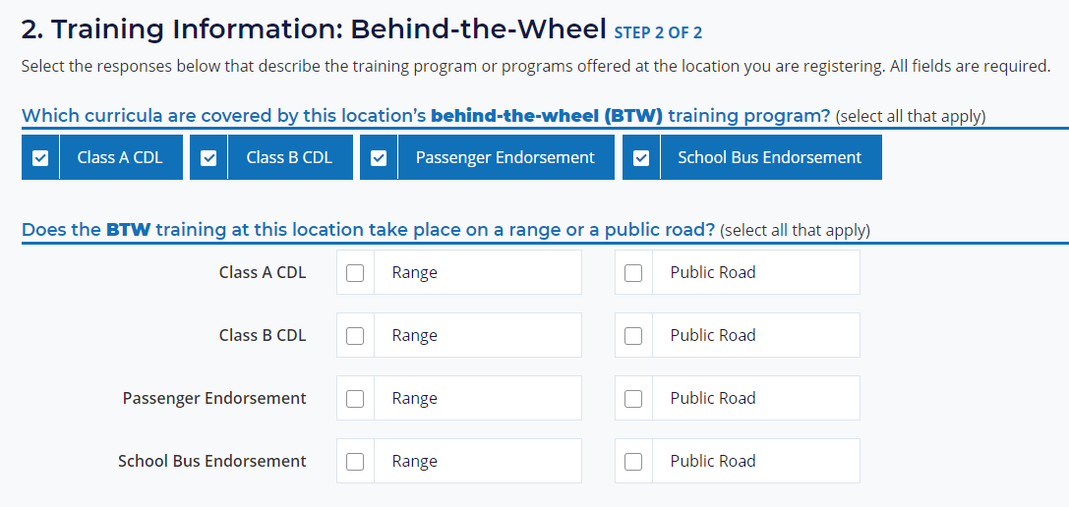
Training Providers: Register Your Location(s) (continued)
When registering your location(s), be sure to select all types of training offered at that location.
Providers are only be able to submit certification information for trainings included in the location registration.
Registered providers can update location registration for accuracy at any time.

Slide 51
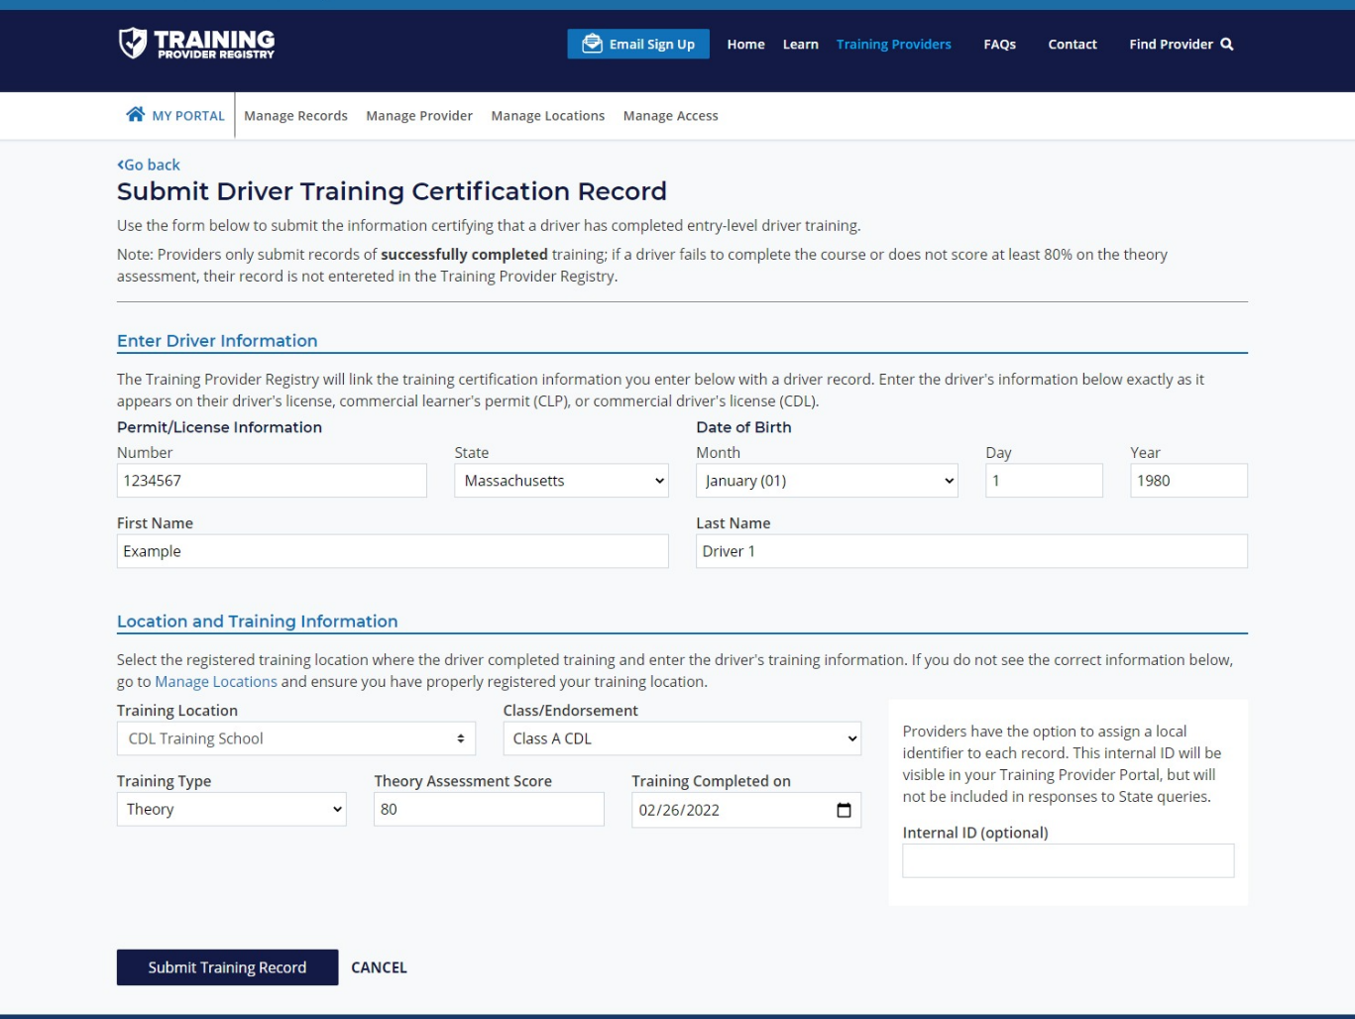
Training Providers: Submitting Driver Training Certification Information
Registered training providers will log in to the Training Provider Portal.
Select Manage Records > Submit a New Record.
Enter the information.
Must select from a registered training location.
Notes:
Registered training providers will log in to the Training Provider Portal
Select Manage Records > Submit a New Record
Enter the information
Must select from a registered training location
NOTE: Traveling providers will need to enter the location address

Slide 52
Training Providers May Use TPR Web Service (Optional)
The TPR Web Service submission option may be a good fit for training providers that:
Anticipate submitting a significant number of driver training certifications on a regular basis.
Have an existing IT system to track driver training results.
Have an IT support team that can update your IT system to interface with TPR Web Service, per the technical specifications in the Web Services Development Handbook.
Learn more at https://tpr.fmcsa.dot.gov/Learn/DeveloperToolkit
Notes:
Training providers with their own IT systems can set up a web interface to submit data via a TPR Web Service.
Building a connection to the Training Provider Registry to submit driver training information is not for everyone. Here are some things you may want to consider when deciding if the web services submission option is right for you:
Do you anticipate submitting a significant number of driver training certifications on a regular basis? We realize that “a significant number” is subjective, so you should take a look at your business needs and determine of you would see a return on the investment.
Do you have an existing IT system in which you track driving training results? This is a requirement of using the TPR Web Service interface. If you do not, manual entry is likely the best solution for you.
If you have your own IT system, do you have an IT support team that can make the necessary updates to your IT system, and maintain your system so that it can continue operating? If not, again, you will likely want to opt for the manual entry option.

Slide 53
Q&A

Slide 54
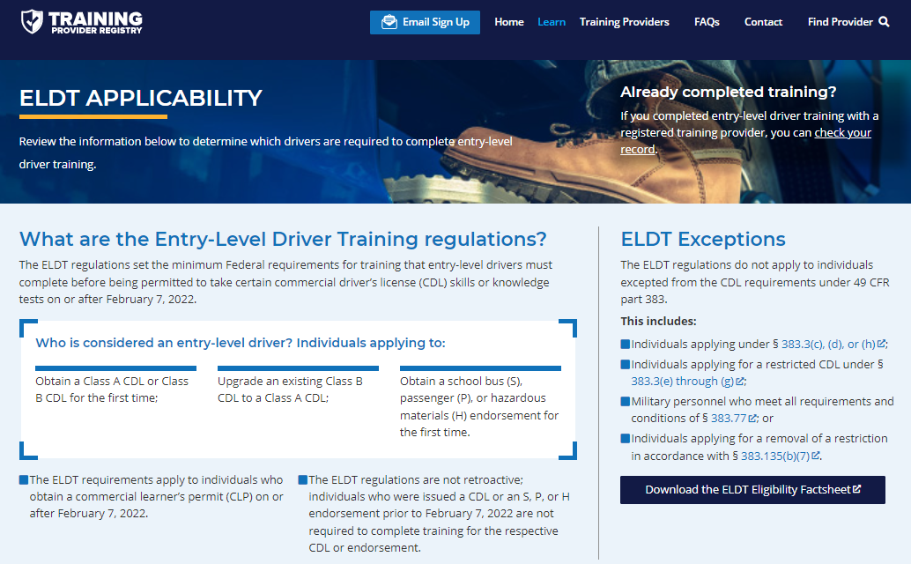
Resources from FMCSA
Visit the TPR website: https://tpr.fmcsa.dot.gov
Sign up for email updates from FMCSA
Find answers to frequently asked questions
Access developer materials to help you build a connection to the TPR Web Service

Slide 55
Questions? Contact Us
To learn more about ELDT and the Training Provider Registry, visit:
https://tpr.fmcsa.dot.gov
<State Contact>
<Name>
<Title>
<email address>
You can also contact FMCSA’s TPR Team:
https://tpr.fmcsa.dot.gov/#contact

